Slide 1
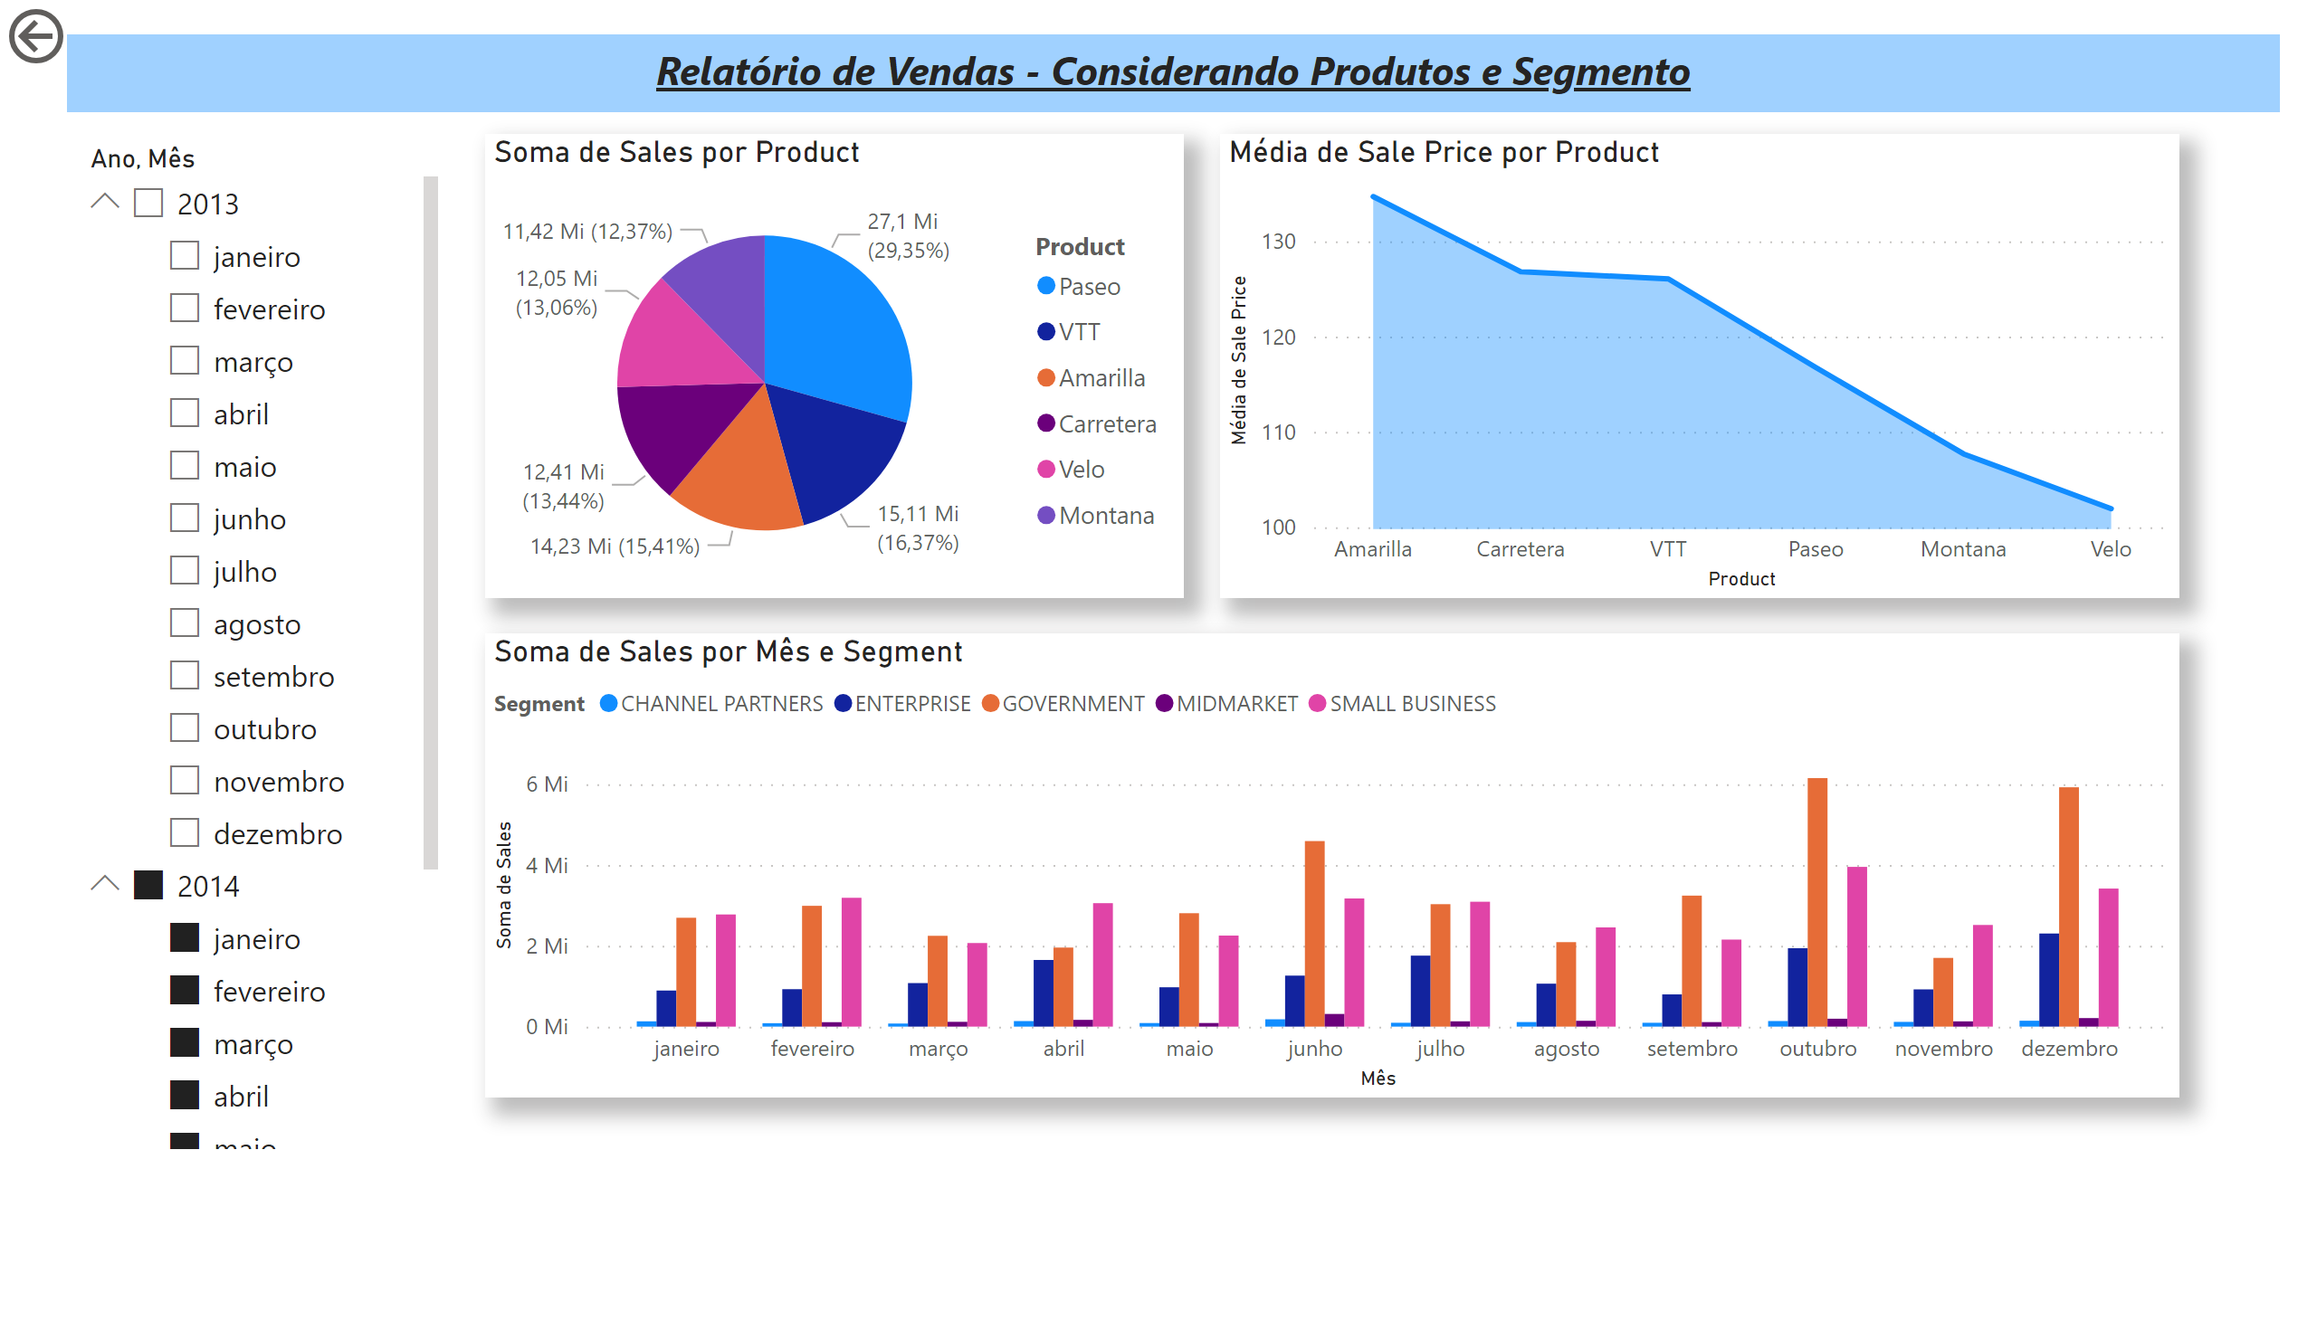
Página 1
Notes:
pieChart
No alt text provided
areaChart
No alt text provided
clusteredColumnChart
No alt text provided
slicer
No alt text provided
actionButton
No alt text provided
textbox
No alt text provided

Slide 2
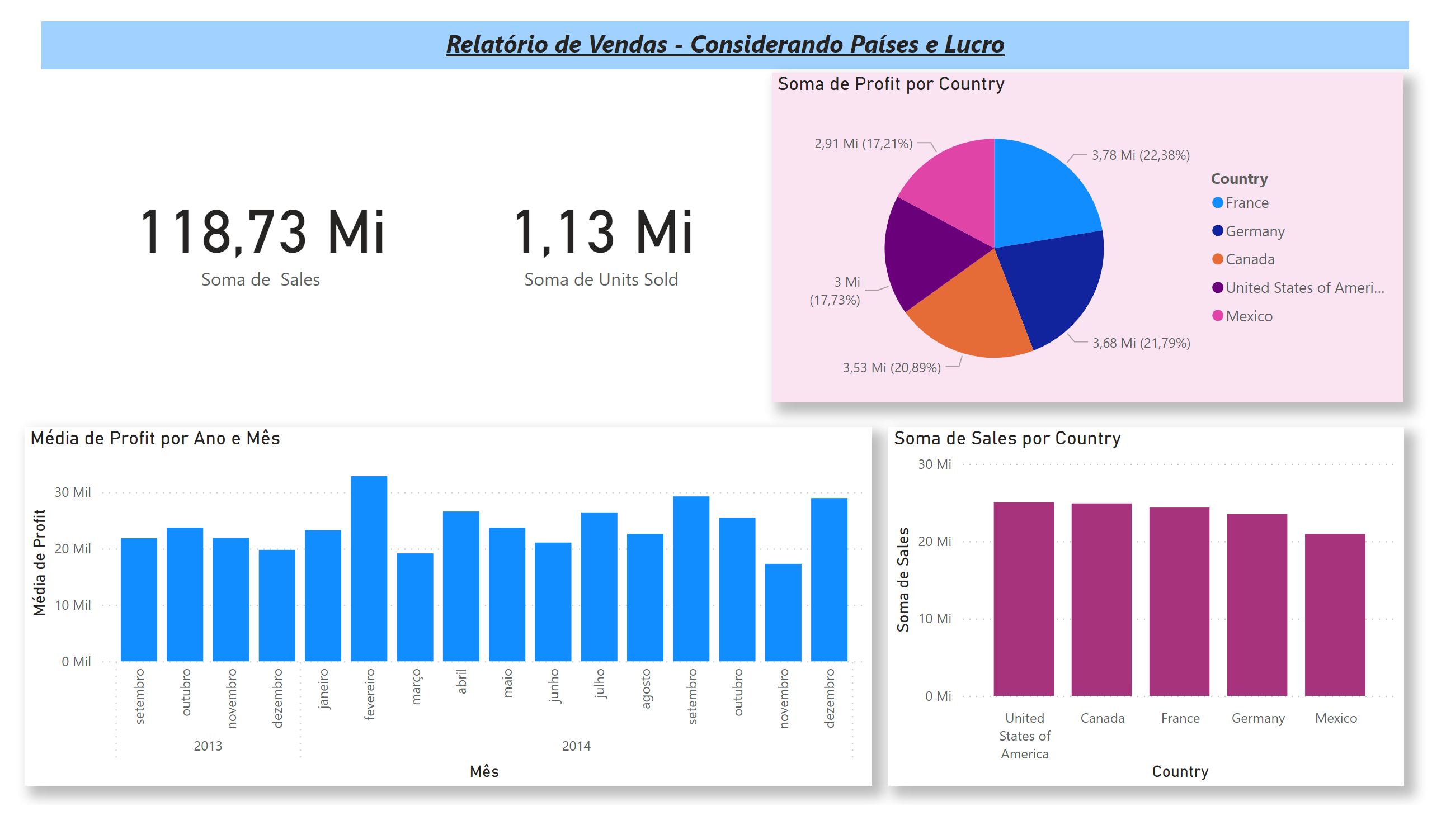
Página 2
Notes:
textbox
No alt text provided
card
No alt text provided
card
No alt text provided
pieChart
No alt text provided
clusteredColumnChart
No alt text provided
clusteredColumnChart
No alt text provided

Slide 3
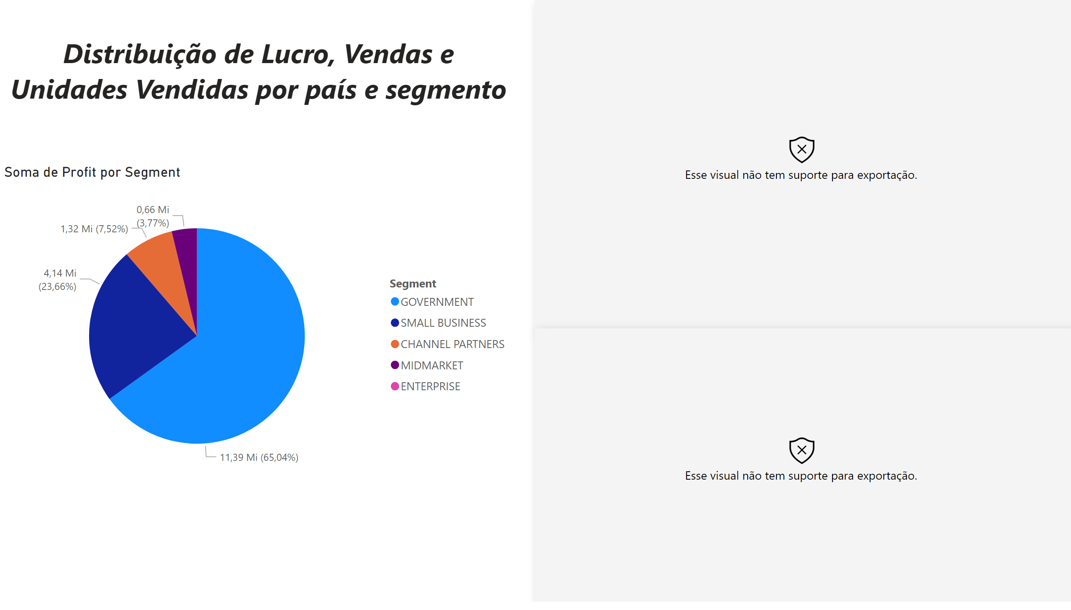
Página 3
Notes:
esriVisual
No alt text provided
esriVisual
No alt text provided
pieChart
No alt text provided
textbox
No alt text provided

